Slide 1
Simple Chat Program In-Class Activity 3

Slide 2
The First Phase
static void Main(string[] args) {
//Part 1
//1.Run as Client vs Server
Console.WriteLine("Listening for messages");
//2.User input mode: when user press "I" key.
var userKey = Console.ReadKey();
//3.Display incoming message
//4.Allow for input
//5.Let the user quit
Console.WriteLine($"You typed {userKey.Key}");
Console.Beep();
}

Slide 3
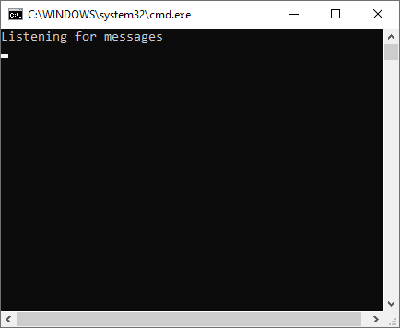
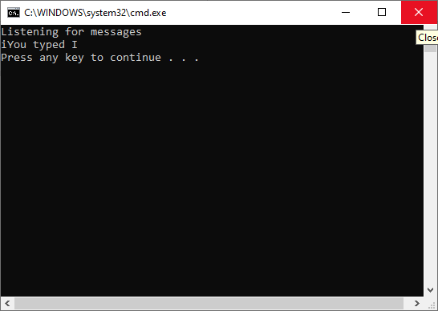
The First Phase
Once the program quit, a Beep sound will be heard.

Slide 4
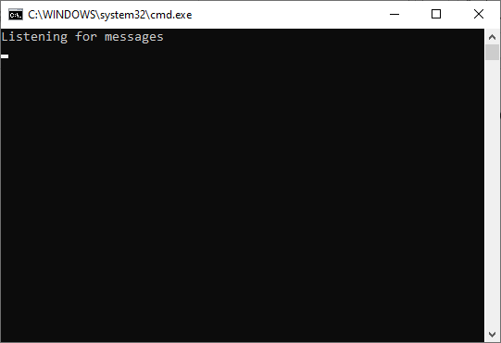
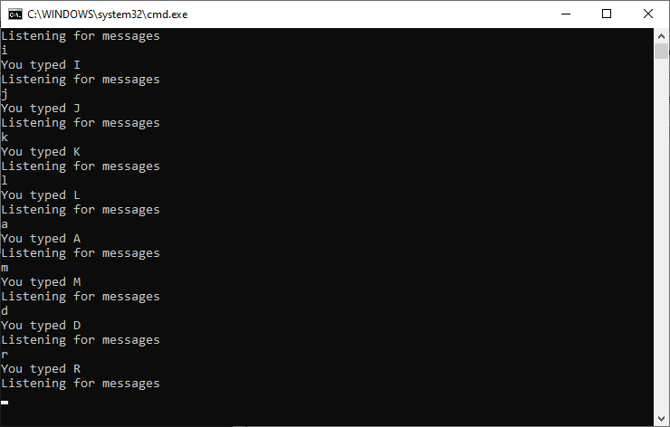
The Second Phase
The program will stay in an infinite loop and keep printing each pressed key

Slide 5
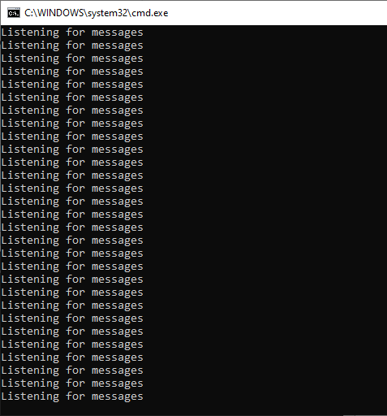
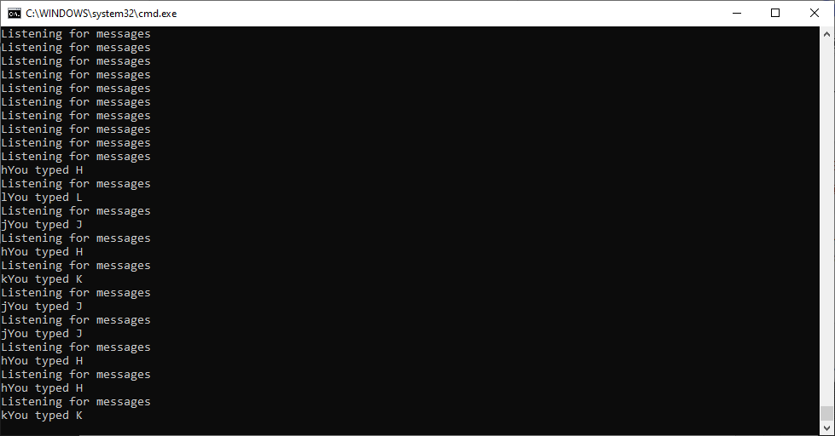
The Third Phase
The program will stay in an infinite loop and keep printing each pressed key with the “Listening for messages” statement.
Hint: Use the while .. Loop and the Sleep method.

Slide 6
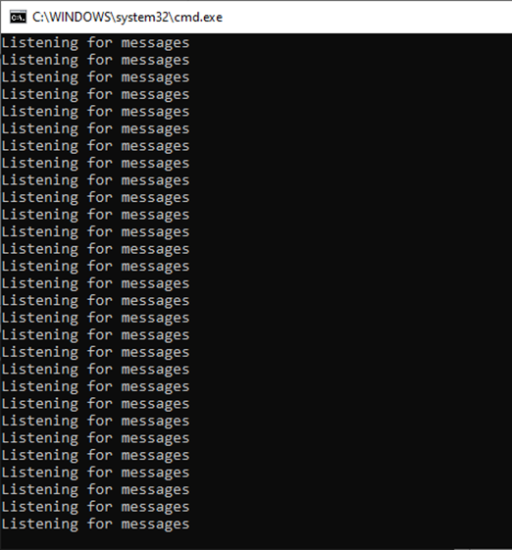
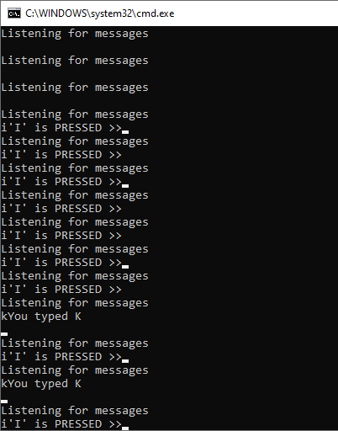
The Fourth Phase
In this phase:
The program will stay in an infinite loop and keep printing each pressed key with the “Listening for messages” statement being repeated. But when the user press i-key it will print : ‘I’ is PRESSED >>
Whereas any other key is pressed it will print the : You typed the D for example if d-key is pressed
Hint: Use the while .. Loop and the Sleep method.
Hint: think about using
ConsoleKeyInfo data type.
ConsoleKey enum data type, e.g., ConsoleKey.I

Slide 7
Simple Chat Program In-Class Activity 4

Slide 8
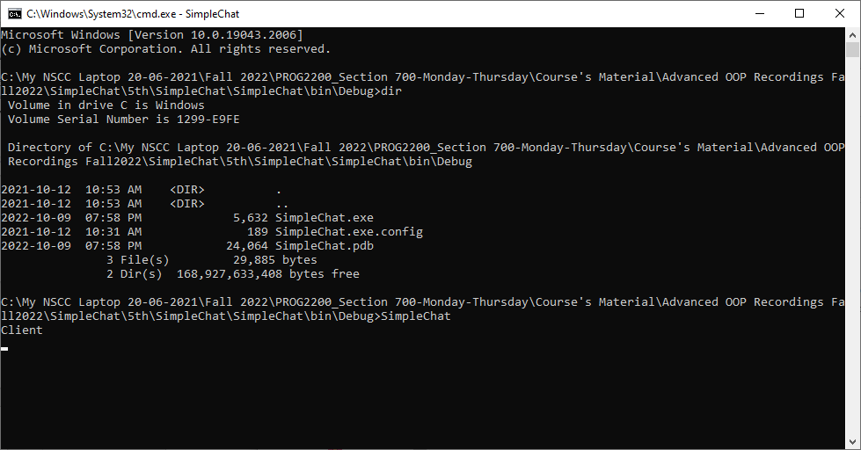
The Fifth Phase
If you run the program from the terminal without adding any argument, then it will be considered as a Client

Slide 9

The Fifth Phase, Cont’d.
If you run the program from the terminal and adding the -server argument, then it will be considered as a Server.

Slide 10
The Sixth Phase, Cont’d.
1. Create a new Class Library project called “ChatLib” inside the previous project. It should contain the following classes:
Server
Client
2. Based on the passed argument, inside PSVM-SimpleChat project, you will instantiate either the Client Class or the server class

Slide 11
The Sixth Phase, Cont’d.
1. Create a new Class Library project called “ChatLib” inside the previous project. It should contain the following classes:
Server
Client
2. Based on the passed argument, inside PSVM-SimpleChat project, you will instantiate either the Client Class or the server class
Now, I want to exit the application (Or stop the running the application) by pressing the Escape key

Slide 12
References & Useful Links
C# Naming Conventions
https://docs.microsoft.com/en-us/dotnet/standard/design-guidelines/general-naming-conventions
Console Application Programming Methods https://docs.microsoft.com/en-us/dotnet/api/system.console?view=netframework-4.7.2

